Slide 1

MET4332 EA
Lam Chi Him 200539776
Lee Chun Kit 200192057
Wong Hin Shun 200041452
Li Ka Ho 200029672

Slide 2
Introduction
Background story
Game name
Genre
Description
Ultrace
One day, Peter wants to break through to the end point in time, and his dream is to become a race car driver. He used his large sum of money to buy a racing track, and he practiced in it constantly.
3D Racing Game
Our game name is Ultrace. Our target groups are teenagers and car lovers. The player can control the car to race. Their goal is to reach the end within a limited time

Slide 3
focus
Since Kinect game is not popular right now. The purpose of our idea is to promote Kinect games. Through this game, we want to let the players know the experience of the Kinect game. We want to promote Kinect game to let more people know the fun of Kinect game, Kinect game into the surface can detect the player's movement to carry out some action inside the game, for example, we are making a racing game, and the player needs to set the control of the corona dial, and twist left and right to control the defense of the car.

Slide 4
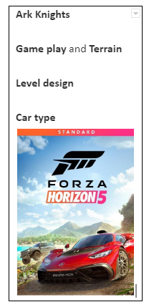
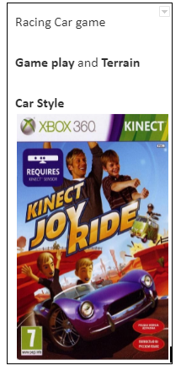
research

Slide 5
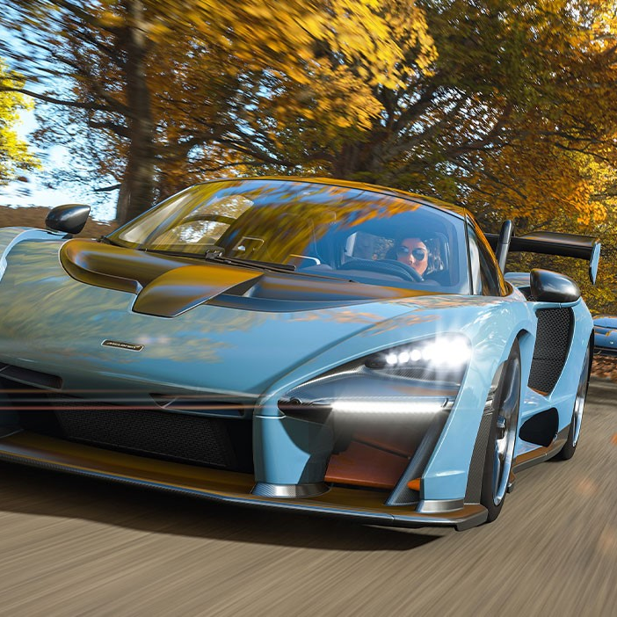
Concept
Core game idea
Our core gameplay concept is to let the player be inside the car, we will be able to use Kinect to control the direction of the car. Where the player can interact with the environment.

Slide 6
Pitch
Unconventional car racing game
Players need to go through the level in a limited time
Cars and scenes are very realistic
Interactive car racing game.
Players need to complete Level 1 to level 3 within 4 minutes so the player can win the game.
Difference level design, car, obstacles, time char
We design different and pretty environments for different scenes. For example, scene 3 is harder than scene 2 and scene 1.
We use some vehicles that are available in the real world, and the venue is somewhat like the real world. We make three large scenes for level 1 to 3 and have a lot of objects in the scene.

Slide 7
Dynamic Environment
In the scene, we will intercept some real-world scenes, such as some houses, buildings, and even some seawater and so on. In addition, there will be some obstacles or some dynamic moving objects to obstruct the player racing. Players need to avoid them in order to reach the end point more effectively.
The car itself will have a blood bar, if the collision is too much or the life value reaches 0 will end the game, so the player needs to be careful to race.

Slide 8
Time Racing
Each level has a time limit to reach the next level, and players need to reach the end point within the time limit to unlock the next level, and they can also keep updating their racing time. And there will be several cars for players to choose from, the venue can also choose their own, but players need to unlock all the levels before they can choose.

Slide 9
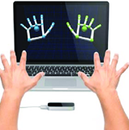
Equipment
This Project requires Leap motion to play and develop. Unlike mouse, keyboard and controller, the input of leap motion is more abstract. Furthermore, leap motion’s detection is more accurate to detect the player’s movement.

Slide 10
How to control
control method is to use your fingers to control
turn left → Overlapping the middle finger can make the vehicle turn left
turn right → Overlapping thumbs can make the vehicle turn right
brake → Overlapping the index finger can make the vehicle brake

Slide 11
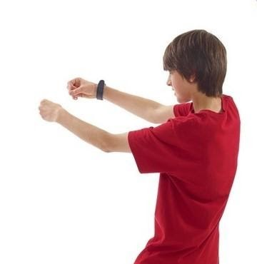
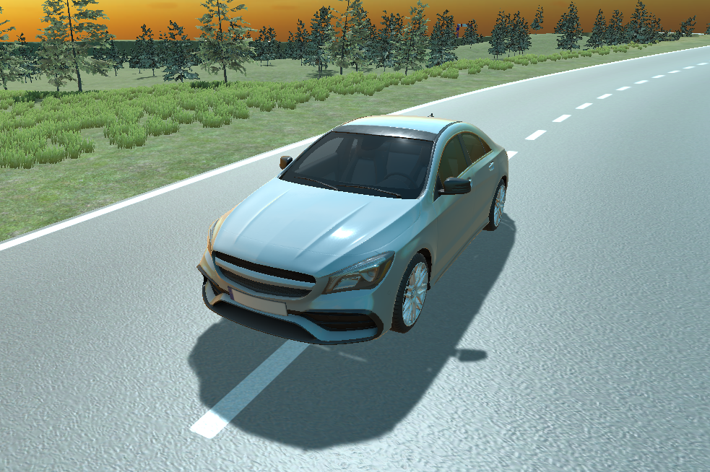
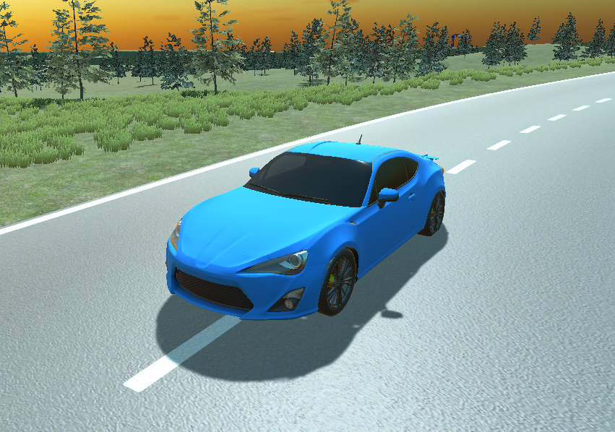
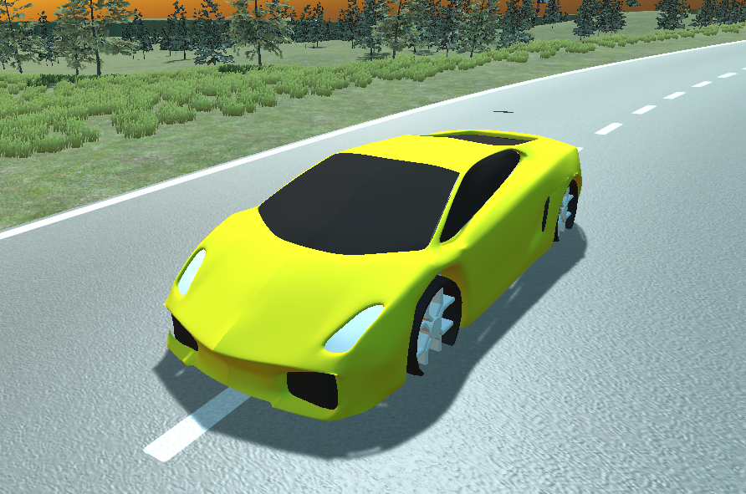
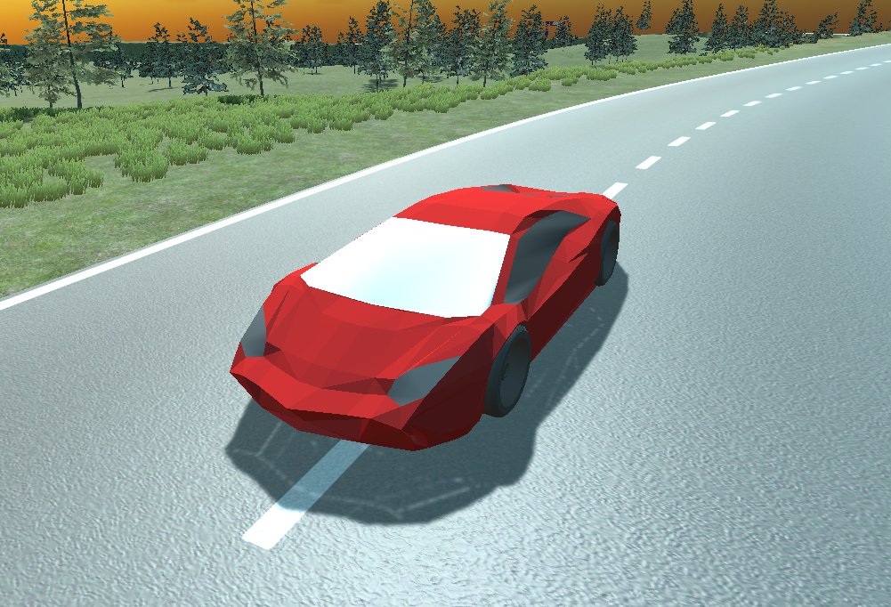
Characters
Player Character
Car
The player character is a pair of giant hands floating in the air.
The objects player controll

Slide 12
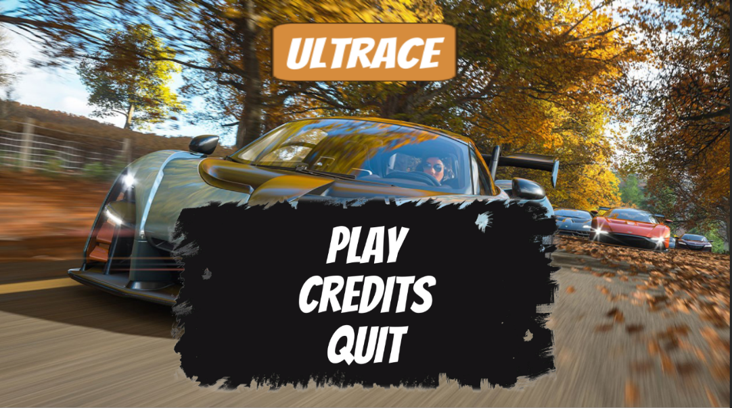
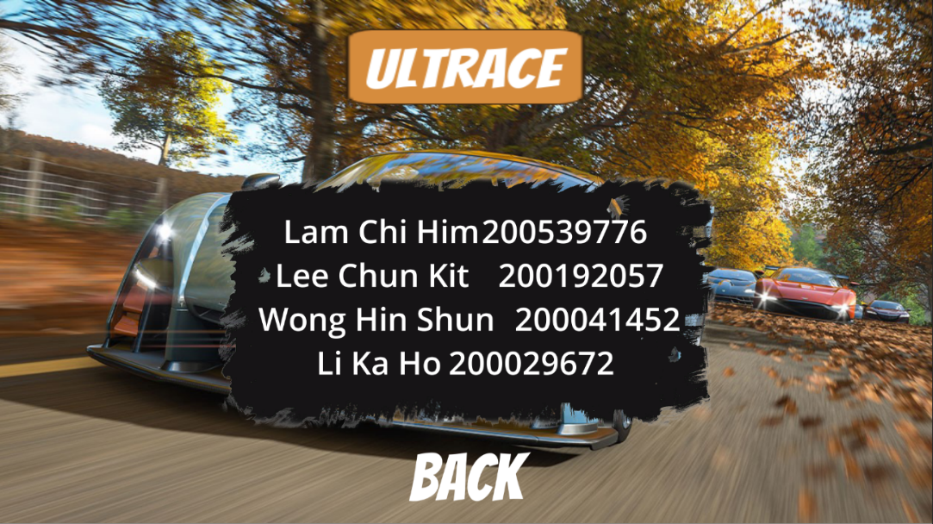
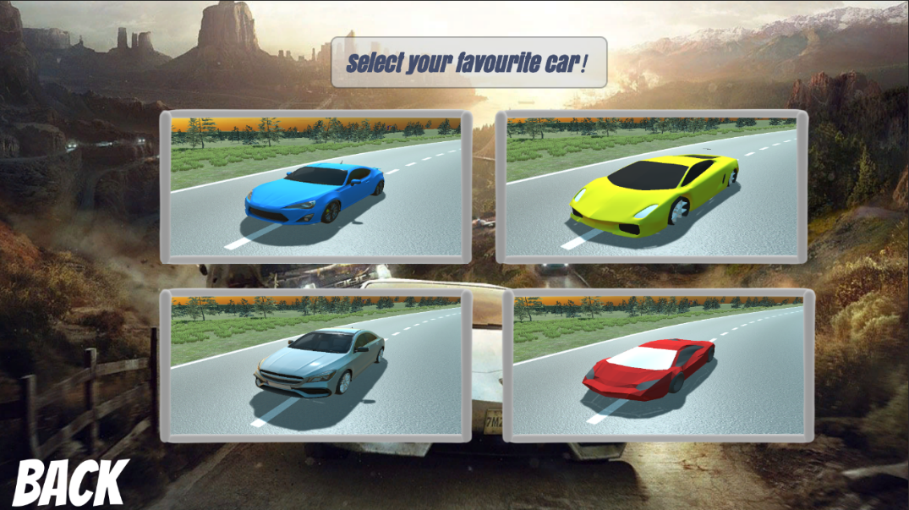
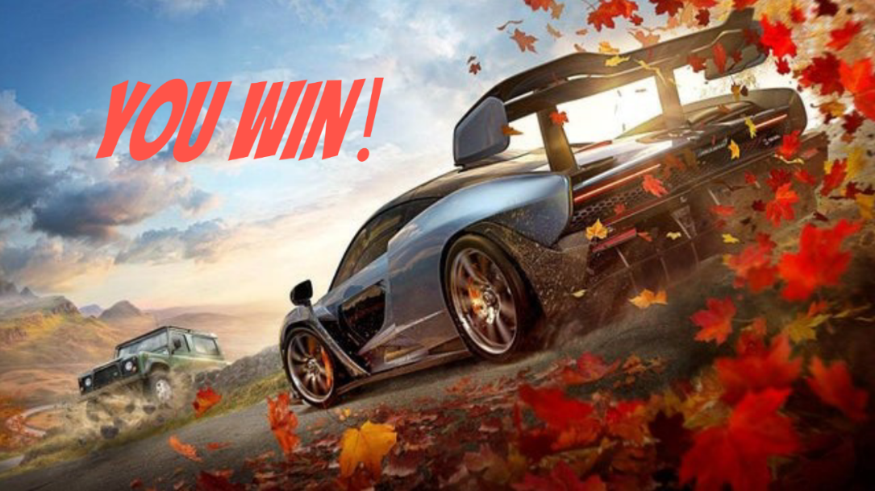
UI Design
Main menu
Credits screen
Select menu
Win screen

Slide 13

Game Design
Time
We can see the above time to show the player their time for each game, and the time will continue to the next level, player needs to reach the level within four minutes.

Slide 14
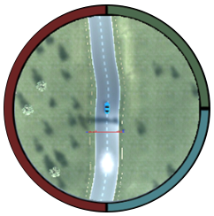
Game Design
Mini map
We can see the mini map in the lower left corner to show the player their location and nearby roads, so that the player can know the information on the map.

Slide 15
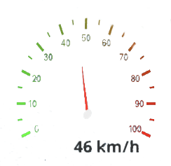
Game Design
Car speedometer
We show a speedometer to the player, so that the player can immediately clear and see what their current speed is, so that the player can know the need to slow down when turning, and so on.

Slide 16
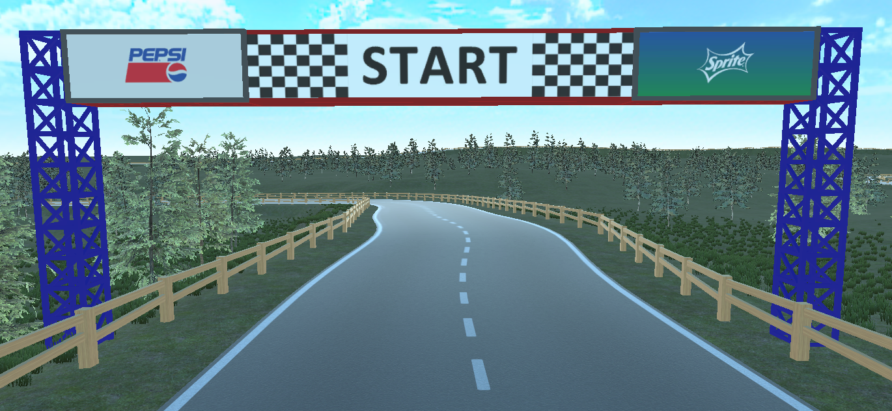
Game Design
Starting Time

Slide 17
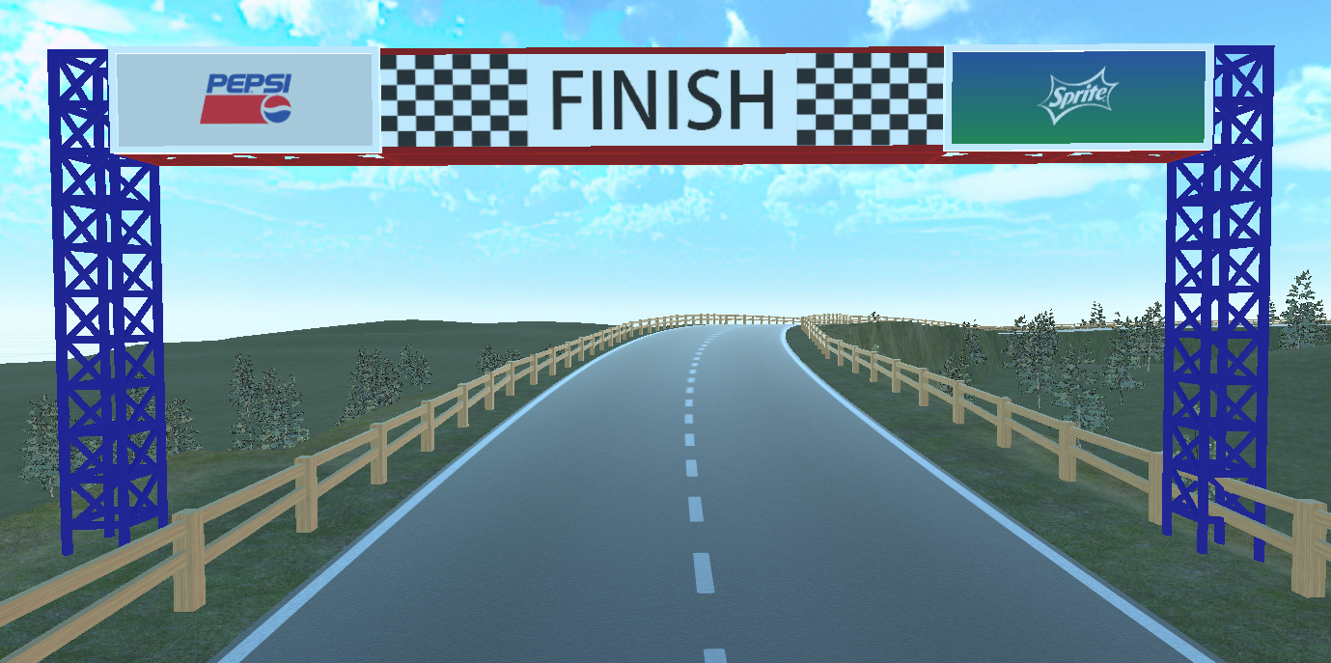
Game Design
ending Time

Slide 18
Level Design

Slide 19
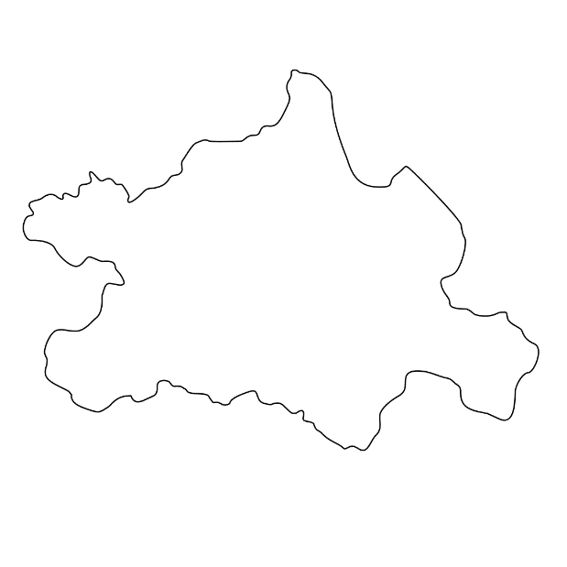

Draft Level 2 Design
Draft Level 3 Design

Slide 20
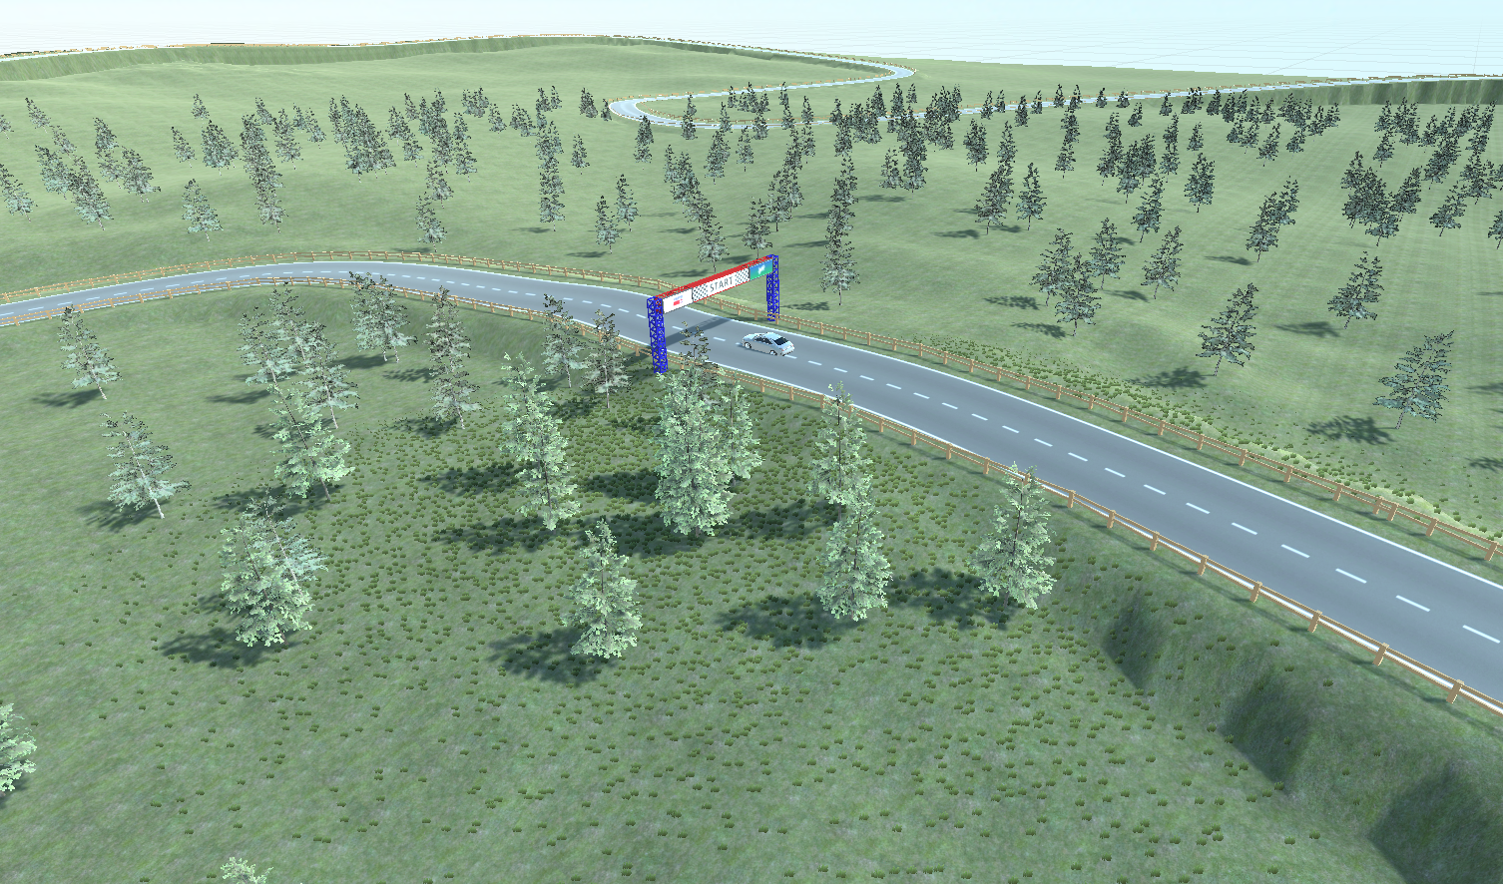
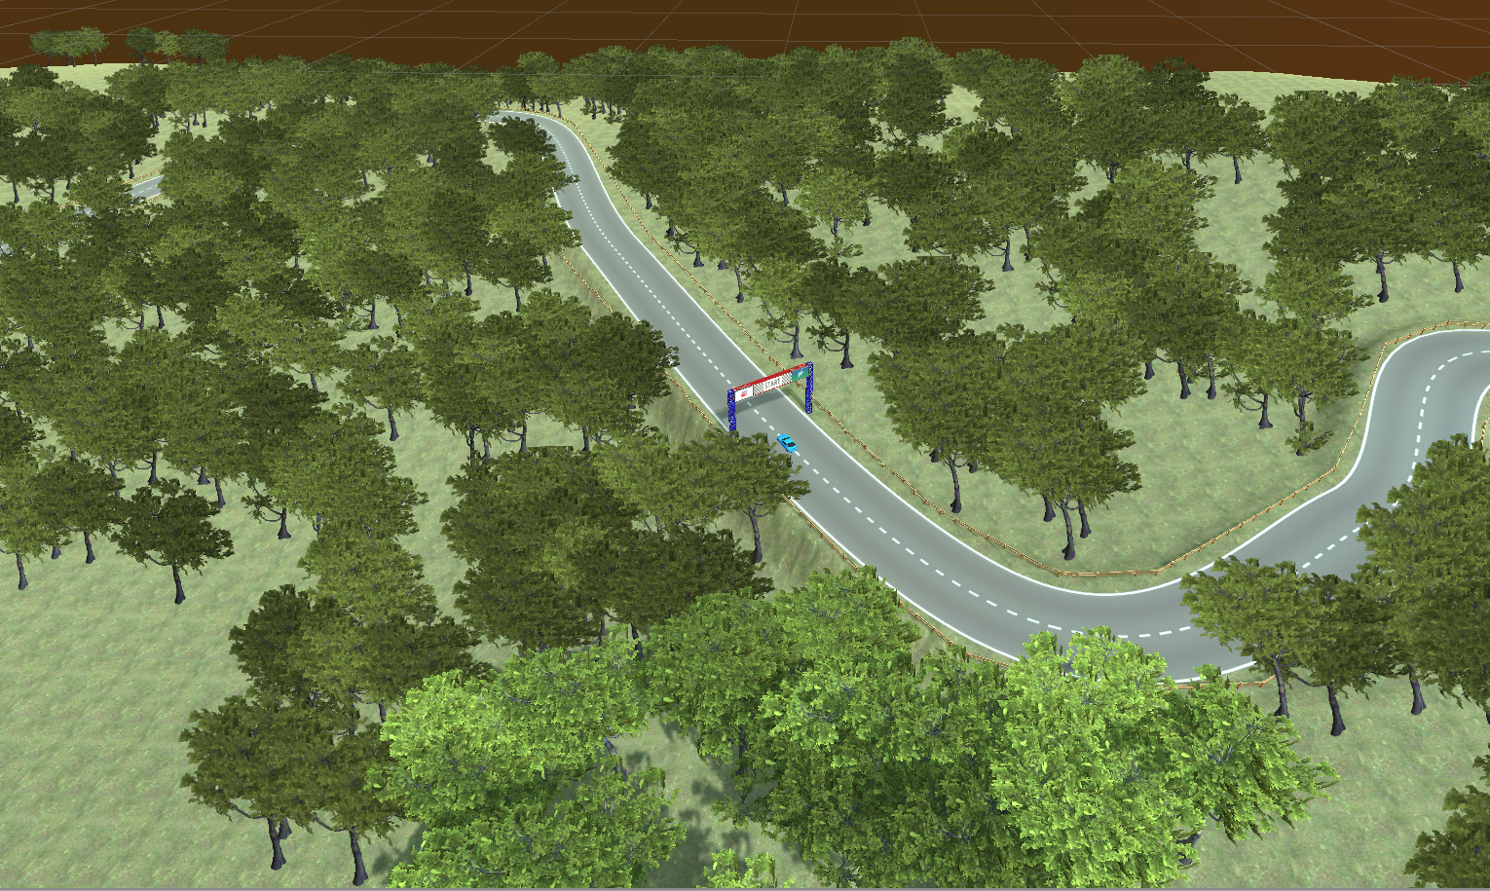
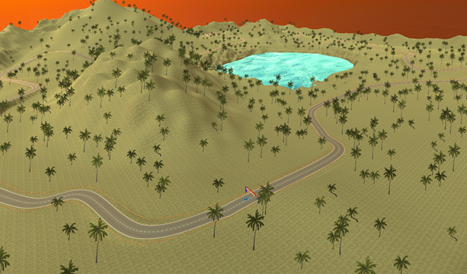
Scene 1
Scene 3
Scene 2

Slide 21
Audio Effect Design
As for the car audio, we use the engine sound style as four channels. For the four channels, we have four audio clips, lowAccelClip, lowDecelClip, highAccelClip and highDecelClip. I public sound effect data to give us to adjust sound level.
In real life, cars have the engine sound, Wheel sound, stop sound and start sound. Car engine sound, I categorize it into four stages, according to our speed, driving speed, and then adjust the data, under what circumstances will play our four kinds of audio, so that our car has the same sound effect as a real car.

Slide 22
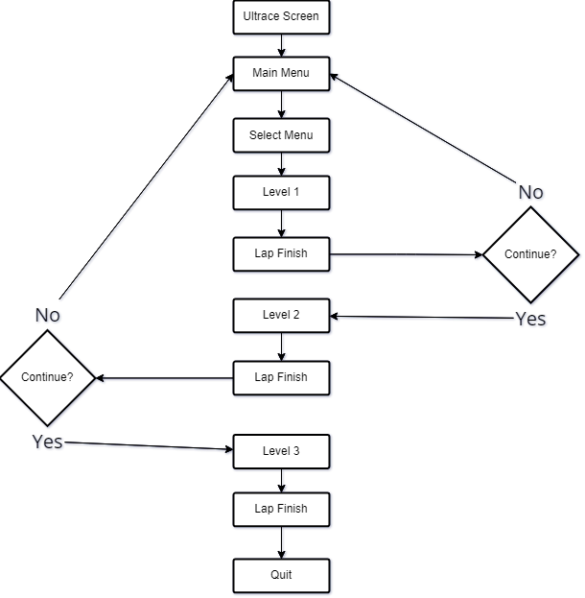
Game Flow Programming

Slide 23
References
Forza Horizon 5 : Car Racing game
https://www.microsoft.com/zh-hk/p/forza-horizon-5/9nnx1vvr3knq?activetab=pivot:overviewtab
KINECT JOYRIDE
https://www.youtube.com/watch?v=NPYR6KGEtvE

